Slide 1






ASP.NET Validation Control
Presented By :
Muhammad Atif Hussain
Head of I.T. (Takaful Pakistan Limited)
Technologies Consultant (AUC Technologies)
MCS(KU)
MSCS(SZABIST)
MCP
MCAD
MCSD
MCTS (Windows, Web, Distributed Applications)
MCPD (Enterprise Applications)
MCT(Microsoft Certified Trainer)

Slide 2
Agenda
Recall
Validating data
Display error messages
Client Side Scripting
Inline JavaScripting
JS
Validation Control
Create custom validation criteria

Slide 3
Recall
Controls
Layout style for Web form
Server controls vs. HTML controls
Bind control values to data items
Write code to respond to user events on controls.

Slide 4
Validating User Input
User gives in an input.
Mostly this will be wrong. ☺
You will have to perform validation and inform user about his wrong data.
There can be two kind of validation.
  Server Side.
  Client Side.

Slide 5
Server Side Validation
This is actually performed by your Code.
This validation is normally called when an event occurs.
This actually increases the load on the server.
The responses are slow.

Slide 6
Client Side Validation
These checks can be done when the client is inputting the data.
This makes your application more interactive and faster.
It also reduces the load on the server.

Slide 7
Traditional way of doing it
Normally JavaScript is used for doing the Client side validation.
But in ASP.NET there is no requirement of knowing JavaScript to do client side validation.

Slide 8
Using Validation
The validation controls check the validity of data entered in associated server controls
It is done before the page is posted back to the server.
Most validity problems can be caught and corrected by the user without a round trip to the server

Slide 9
Validation Controls
RequiredFieldValidator
CompareValidator
RangeValidator
RegularExpressionValidator
CustomValidator
ValidationSummary

Slide 10
Validation Controls
ControlToValidate → This property lets the validator know which control it has to validate. (It binds the validator to that control and then the validator monitors that control.)
ErrorMessage → This is the error message that appears in the validation summary when the control being validated violates the condition set by the validator.
Text →Information that gives guidance to correct the error.

Slide 11
ASP.NET Validation Controls
Validation control | Use to
RequiredFieldValidator | Check whether a control contains data
CompareValidator | Check whether an entered item matches an entry in another control or particular value.
RangeValidator | Check whether an entered item is between two values.
RegularExpressionValidator | Check whether an entered item matches a specified format
CustomValidator | Check the validity of an entered item using a client-side script or a server-side code, or both
ValidationSummary | Display validation errors in a central location or display a general validation error description

Slide 12
Steps to be followed
Draw a validation control on a Web form and set its ControlToValidate property to the control you want to validate. If you’re using the CompareValidator control, you also need to specify the ControlToCompare property.
Set the validation control’s ErrorMessage property to the error message you want displayed if the control’s data is not valid.
Set the validation control’s Text property if you want the validation control to display a message other than the message in the ErrorMessage property when an error occurs. Setting the Text property lets you briefly indicate where the error occurred on the form and display the longer ErrorMessage property in a ValidationSummary control.
Draw a ValidationSummary control on the Web form to display the error messages from the validation controls in one place.
Provide a control that triggers a postback event. Although validation occurs on the client side, validation doesn’t start until a postback is requested.

Slide 13
Required Field Validation
Check if a control contains data.
Properties
  ControltoValidate – the control id which is to be validated.
  ErrorMessage – the error message to be shown when validation occurs.
  InitialValue - Error is thrown when this value does not change.
  Enabled - to make the validation enabled.

Slide 14
Regular Expression Validator
Check if an entered item matches a specified format (Expression)
Properties
  ControltoValidate
  ErrorMessage
  InitialValue
  ValidationExpression
  Enabled

Slide 15
Demo
RequiredFieldValidator
RegularExpressionValidator

Slide 16
Demo
A regular expression is a string that contains special symbols that can be used to match patterns of characters.
Ex:
  dir *.*
  Means “Display all files in the current directory.”

Slide 17
Regular Expression Elements
“.”- Matches one character
“$”-Mathces pattern at the end of the string.
  Ex: (hello)$
  I said hello (Matches)
  Did you say hello? (Does not match)
“^”- Matches patterns at the beginning of a string.
When used in [ ], reverses the meaning [i.e. not]
Ex: [^aeiou] – Match any one character other than in the list

Slide 18
Regular Expression Elements
{ }- Used to match certain quantity of characters.
  Ex: hello{2} –matches a string “hellohello”
[ ]- Used to match any one of characters.
  Ex: [aeiou] – Matches any one from list
  Ex: [a-z] – To specify range.
()- Used for grouping strings

Slide 19
Regular Expression Elements
“|”- Means logical OR
  Ex: (hello)|(HELLO)- Match either “hello” or “HELLO”.
“*”- Matches zero or more mathces
  Ex: h*ello- Matches zero or more occurrences of the letter h, followed by ”ello”.
“+”- Matches one or more matches
  Ex: h+ello- Matches one or more occurrences of the letter h, followed by ”ello”. But not ”ello”.

Slide 20
Regular Expression Elements
“?”- Matches zero or one occurrence
  Ex: h?ello -Matches “ello” and “hello” but not “hhhello”.
“\” – An escape character. When any of the previous character are preceded by the backslash, they are matched literally.
  Ex: h\*ello- Matches “h*ello” but not “h\*ello”

Slide 21
Few regular Expressions
First to validate a number sequence
\d{6} (indian Pincode)
\d{3}-\d{2}-\d{4}

Slide 22
Few regular Expressions
Email address validation
\w+([-.]\w+)*@\w+([-.]\w+)*\.\w+([-.]\w+)*
So what does \w mean --- It means a word can occur.
+ means or
* means zero or more occurances.

Slide 23
Validation Summary
It is used when you want to group all the error messages at one location.
Used to group all the error messages.
Demo

Slide 24
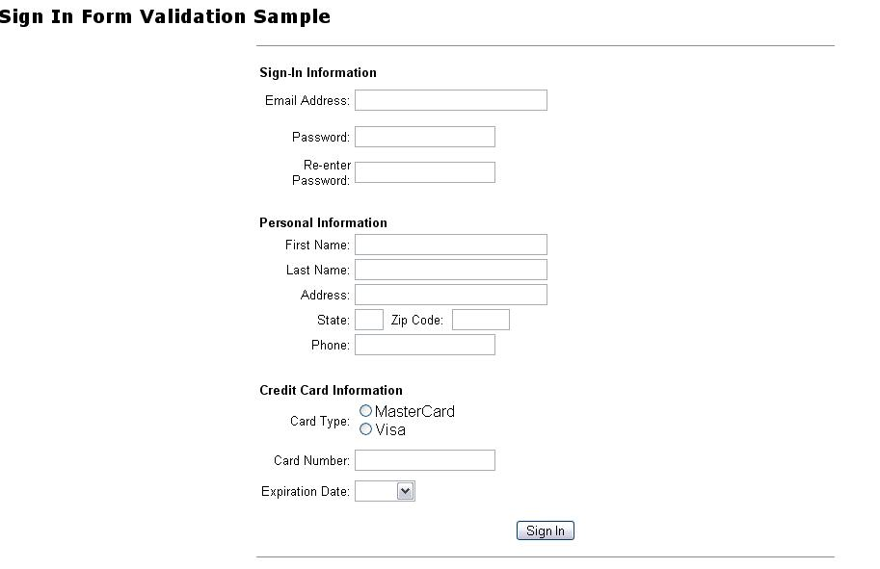
Exercise

Slide 25
Exercise
What is validation?
Why to validate data on a webform?
Controls to validate.
Using Regular expressions
Using Validation Summary

Slide 26


Slide 27
Questions
?

